Slide 1
Neuro-Evolution of Augmenting Topologies
Ben Trewhella

Slide 2
Background
Presented by Ken Stanley and Risto Miikkulainen at University of Texas, 2002
Currently lead by Ken Stanley at EPLEX, University of Central Florida
Has found applications in agent control, navigation, content generation

Slide 3
Summary
Essentially an evolutionary method of creating neural networks
Start with a Genotype:
  A number of nodes [id, type = {input, bias, hidden, output}]
  A number of links [from, to, weight, enabled]
This can be matured to a Phenotype (Neural Net)
  Problem solver
  Agent brain
  Content creator

Slide 4
Creation
Start with the simplest network possible
Generate an initial population by mutating weights and structure
Any unique structural change is assigned a global innovation number
Evaluate fitness of neural nets (if solution lead)

Slide 5
Crossover
Global innovation numbers allow
parent genes to be matched and
crossed without creating broken nets
Solves the ‘competing conventions’
issue – where two fit parents have weak
offspring e.g.
{ABCD} x {DCBA} = {ABBA} or {CDDC}

Slide 6
Speciation
A mutation will generally lower the performance of a network until trained
To protect new mutations they can be placed in a new species
Species worked out by number of disjoint innovations and weight averages
Species will compete, any that do not show improvements are culled

Slide 7
Performance
Very fast in reference problems such XOR network, pole balancing
Evolution of weights solves problems faster
than reinforcement learning through back propagation of error

Slide 8
Extensions: CPPN and HyperNEAT
Compositional Pattern Producing Networks
www.picbreeder.com

Slide 9
CPPN Particle Effects
Galactic Arms Race

Slide 10

CPPN Music
Evolving drum tracks through musical scaffolding
  Generation 1
  Generation 11

Slide 11
Extensions: rtNeat
Real Time NEAT
Used in the NERO simulation
  Behaviors are created in real time
  The player rewards positive behaviors which raises the fitness of genomes

Slide 12
Agent and Multi Agent Learning
Agents – connect sensors to inputs
Multi - Agents – cross wire sensors

Slide 13
Fine grained control
Controlling an Octopus arm

Slide 14
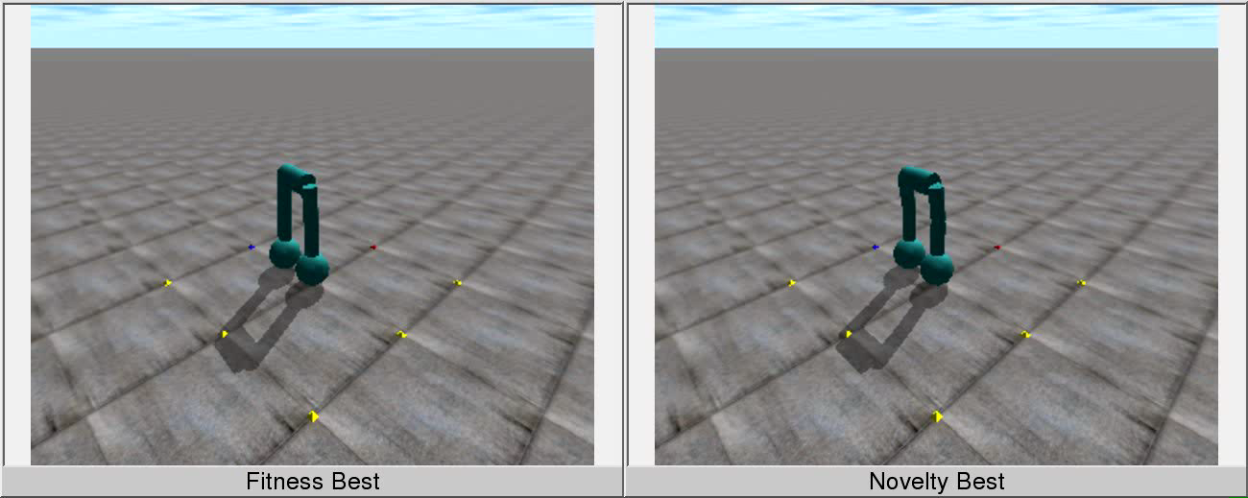
Search for Novelty
Base fitness on doing something new
rather than smallest error

Slide 15
Discussion
Picbreeder - very difficult to rediscover a picture
However very complex forms evolve
By searching for novelty alone we can discover more interesting designs
than by searching for specific features

Slide 16
Next Steps
Building an Objective C implementation of NEATS, progress is good
Possibly build a Processing implementation afterwards
Continue materials review in other subjects, looking for applications of NEATS

Slide 17
Reference
Stanley, K. O. & Miikkulainen, R.
Efficient Evolution Of Neural Network Topologies
Proceedings of the Genetic and Evolutionary Computation Conference, 2002
Stanley, K. O. & Miikkulainen, R.
Efficient Reinforcement Learning Through Evolving Neural Network Topologies
Proceedings of the Genetic and Evolutionary Computation Conference, 2002
Stanley, K. O. & Miikkulainen, R.
Continual Coevolution Through Complexification
Proceedings of the Genetic and Evolutionary Computation Conference, 2002
D'Ambrosio, D. B. & Stanley, K.
Generative Encoding for Mutliagent Learning
Proceedings of the Genetic and Evolutionary Conference, 2008
Stanley, K.
Compositional Pattern Producing Networks
Genetic Programming and Evolvable Machines, 2007

Slide 18
Reference
Hastings, E.; Guha, R. & Stanley, K. O.
NEAT Particles: Design, Representation, and Animation of Particle System Effects
Proceedings of the IEEE 2007 Symposium on Computational Intelligence and Games, 2007
Amy K Hoover, Michael P Rosario, K. O. S.
Scaffolding for Interactively Evolving Novel Drum Tracks for Existing Songs
Proceedings of the Sixth European Workshop on Evolutionary and Biologically Inspired Music, Sound, Art and Design, 2008
Jimmy Secretan, Nicholas Beato, D. D. A. R. A. C. & Stanley, K.
Picbreeder: Evolving Pictures Collaboratively Online
Proceedings of the Computer Human Interaction Conference, 2008
Lehman, J. & Stanley, K. O.
Exploiting Open-Endedness to Solve Problems Through the Search for Novelty
Proceedings of the Elenth International Conference on Artificial Life, 2008
Kenneth O Stanley, David B D'Ambrosio, J. G.
A Hypercube-Based encoding for Evolving Large-Scale Neural Networks
Artificial Life Journal 15(2), MIT Press, 2009
Erin J Hastings, R. G. & Stanley, K.
Interactive Evolution of Particle Systems for Computer Graphics and Animation
IEEE Transactions on Evolutionary Computation, 2009

Slide 19
Reference
Sebastian Risi, Sandy D VanderBleek, C. E. H. & Stanley, K. O.
How Novelty Search Escapes the Deceptive Trap of Learning to Learn
Proceedings of the Genetic and Evolutionary Computation Conference, 2009
Erin Hastings, R. G. & Stanley, K.
Automatic Content Generation in the Galactic Arms Race
IEEE Transactions on Computational Intelligence and AI in Games, 2009
Erin Hastings, R. G. & Stanley, K.
Demonstrating Automatic Content Generation in the Galactic Arms Race Video Game
Proceedings of the Artificial Intelligence and Interactive Digital Entertainment Conference Demonstration Program, 2009
Woolley, B. G. & Stanley, K. O.
Evolving a Single Scalable Controller for an Octopus Arm with a Variable Number of Segments
Proceedings of the 11th International Conference on Parallel Problem Solving from Nature, 2010
Lehman, J. & Stanley, K. O.
Abandoning Objectives: Evolution Through the Search for Novelty Alone
Evolutionary Computation Journal(19), MIT Press, 2011

